Slide 1

Capstone project
- By Lakshmi Sathiraju

Slide 2

Capstone Project – Rent a House
Business Problem:
Mr. John trying to rent a House in Bengaluru, India
Has some preferred locations in his mind.
He has some requirements to be met in his preferred locations, to rent a house.
Not sure where to rent a house !!!

Slide 3

Capstone Project – Rent a House
Can we use Data Science Methodologies to help Mr. John find his dream location ?

Slide 4
Capstone Project – Rent a House
Data Science has the capability to:
Collect and Process the Locations, Neighbourhoods and Venues data.
Find the right neighbourhoods in user’s preferred locations.
Make sure that all the user requirements are satisfied.
Demonstrate the RESULTS to the user with Graphical images and Maps.
Suggest the best choice to rent a house

Slide 5
Capstone Project – Rent a House
Tools and Capabilities of Python and Data Science
Foursquare API – Location Based Service.
Folium – Leaflet Maps.
Pandas – Data Manipulation and Analysis.
Numpy – Scientific Computing and Mathematics.
Matplotlib – Plotting Library.
Algorithms – To arrive at the right conclusion.

Slide 6
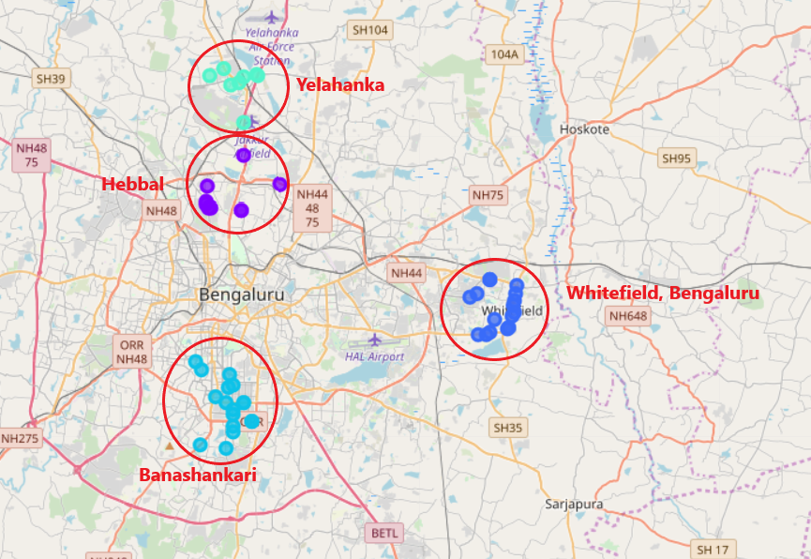
Capstone Project – Rent a House
How to Suggest the best location to rent out ?
Get the Latitudes and Longitudes of preferred locations, which are:
Yelahanka
Hebbal
Banashankari
Whitefield
Get the neighbourhoods of these locations.
Get the nearby Venues and their Categories.
Filter out any unwanted Venue, which user is not looking for.
Plot them on a Map for Visualization.
Make sure that all the preferences of the user has satisfied.
Suggest the best Location to Rent !!

Slide 7
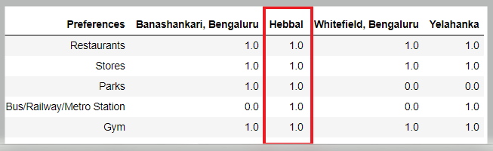

Capstone Project – Rent a House
Conclusion:
Rent a House in “Hebbal” as it has all the preferences, which user is looking for !!
Result:
Happy users !!

